Slide 1



Business Proposal Pitch
Baby Nanny
An AI-Powered Baby Care System

Slide 2

Project Introduction
Market Analysis
01
03
CONTENTS
02
04
Team Introduction
Business Model

Slide 3
01
Team Introduction
PART ONE

Slide 4
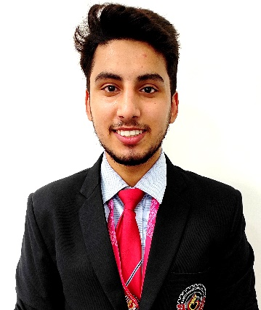
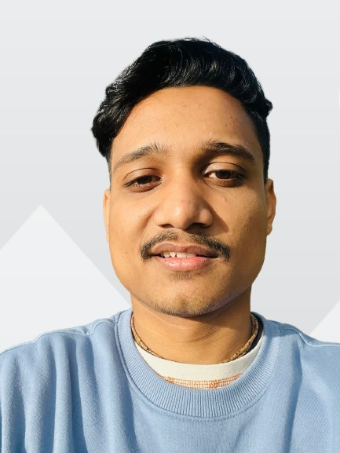

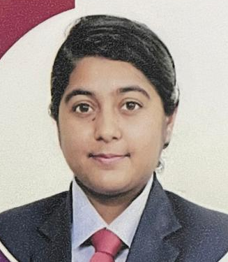
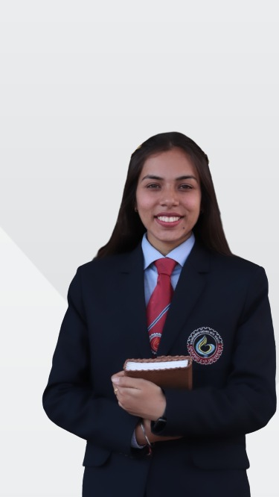
01
Team
Deepankar Sharma
Vipin Kumar
Technical Head
Executive Head
BCA,
Graphic Era Hill University With his idea and initial research, he laid the foundation of this project.
BCA,
Graphic Era Hill University
He has worked with different startups and currently leading the overall progress of the project.
Gurpreet Kaur Jassal
Himani Taneja
Developer
Developer
BCA,
Graphic Era Hill University
She is currently working on mobile application development
BSc IT,
Graphic Era Hill University
She is currently working in the web development.

Slide 5
02
Project Introduction
PART TWO

Slide 6
02
Problem Statement and Value Proposition
Both Parents are busy/working
Single Parent
Small babies can’t say what they want
Not every parents know the best (specially first time)
Insufficient Childcare
“ Small babies don’t exactly express themselves in words, so this system is focused on identifying their needs with the help of the existing AI technology around us. ”
Prior Existing Solutions
Babysitters
Childcare Institutions
Let some relative or guardian take care
Baby Care toys (not smart enough)

Slide 7
02
Physical Structure of our Solution
We are using smart emotion detection, real-time video streaming, customized RL assistant with an implicit feedback loop.
CNN and NLP for Emotion Recognition
Community App (Advices from Others)
1
3
Hyper Personalized Reinforcement Learning based Assistant ( Learn as Child Grows )
Premium features including Smart Surveillance Intergration & Real Time Feed Monitoring
2
4

Slide 8



02
Working of the RL based Recommendation system
suppose your baby loves watching chota bheem
now model made a random decision to play Ben 10
Realtime Emotion Recognition ---> baby seems happy (positive reward for model)
The model will learn: “Your baby likes Ben 10”

Slide 9
03
Business Model
PART THREE

Slide 10
03
Implementation Plan
Timeline process
Step 02
Step 04
Introduction of freemium and premium services
Integration into manufacturing complete systems
Step 01
Step 03
Launching of the App and Website of Baby Nanny initially to build up the community.
Smart home IOT integration as per premium plan selected.

Slide 11
03
Revenue Model
How are we going to make money ?
The system will come in various freemium and premium services where the parents will have an opportunity to interact with the community based on parenting for free over the app and website.
Our premium services will cost 10-20K INR(flexible depending upon the hardware customizations).
Although App and Website are free!!!
At later stages, the website will be a source of revenue generation via selling and buying childcare products over the website itself.

Slide 12
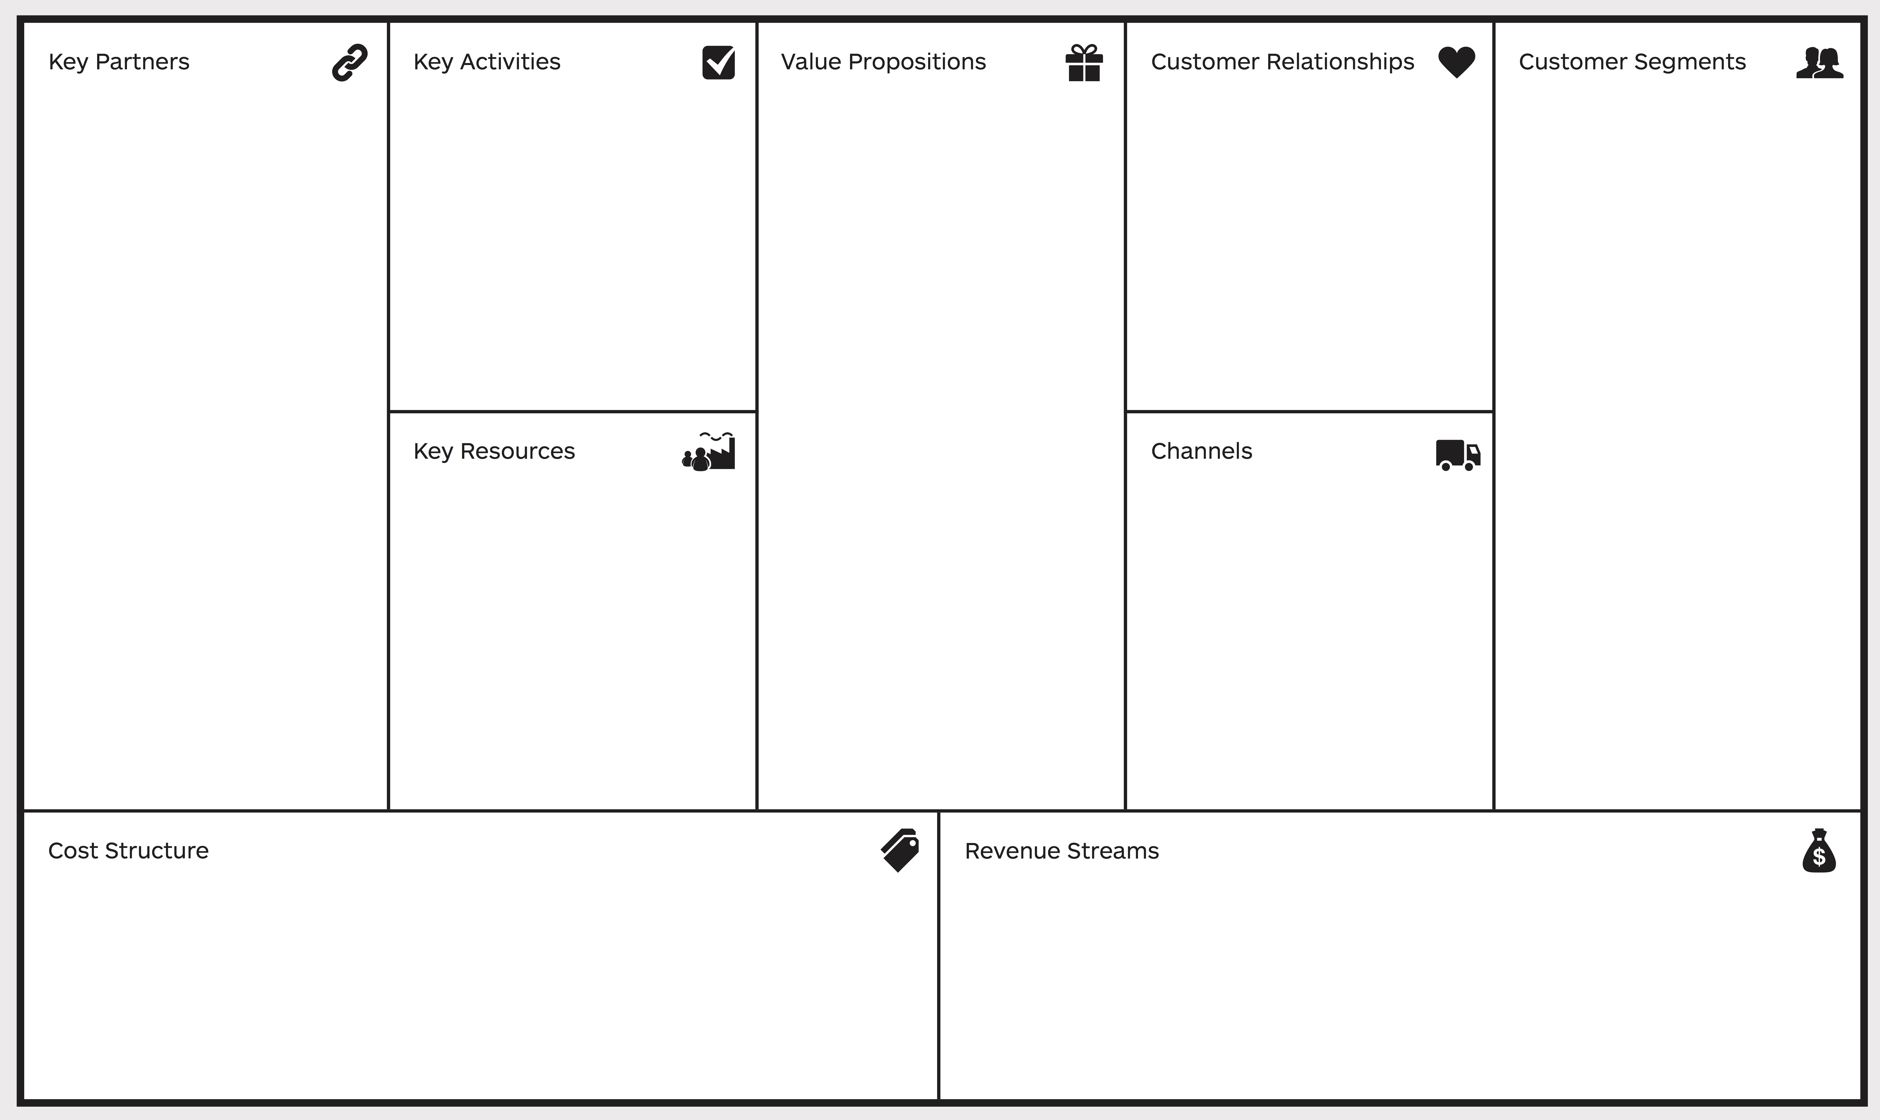
03
Business Model Canvas
community building & effective parenting
more personalized way of knowing what your child wants
customized RL enabled implicit feedback loop
Inbuilt community support in the app/website
Add ons – exquisite premium services like smart baby surveillance and real- time feed monitoring.
free app/website
freemium services
personalized RL based feedbacks
flexible premium & add ons plans
developers
single parents
working parents
adoption houses
general parents
childcare institutions
SEO
Social Media Advertising
Mobile App
Website
Website
Mobile App
Cloud Services
RL based Assistant
Add ons...
Infrastructure Cost (High specs systems, electricity)
Cloud Services
Staff Maintainence
Marketing Cost
app / website
premium services
maintainence services
with strong community-integration into Aggregator Business Model
opportunity cost

Slide 13
04
Market Analysis
PART FOUR

Slide 14
04
Competitive Landscape
There’s no other company working in this exact field but there are a few companies working in the subfields of our complete idea.
A few of them are – India Parenting, Parent Circle.
Our USP Advantages
Problem 1 – Parenting apps with lack of personalization.
Solution – Customized RL enabled implicit feedback loop
Problem 2 – Lack of bright parenting application/website.
Solution – Inbuilt community support in the app/website
Add ons – Exquisite premium services like smart baby surveillance and real- time feed monitoring.

Slide 15
04
Funding Objective
How much do we need!
We’re expecting around INR 10,00,000/- of funding against 10.5% equity. We’ll use those funds to start our company where we’ll develop those remaining parts of our project which are lacking behind because of money:
Paid Cloud Services
Infrastructure for development of more Accurate ML models for better results
Data Collection
etc.
Also, we’ll put that money into creating our initial customer base.

Slide 16
04
Milestones
Patented the idea – March 2022
Won Navikaranan’23, National Level Entrepreneurship and Innovation Fest at NIT Uttarakhand – February 2023

Slide 17
Thank You

